Slide 1
Actionscript 3.0 Basics
1 – Syntax, OOP, Data Structures

Slide 2

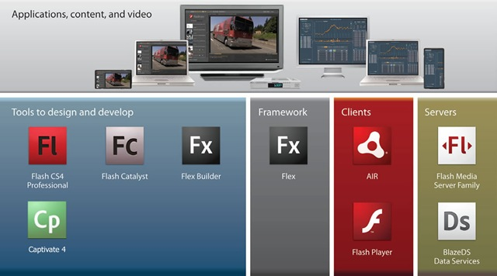
Flash Platform
Is a stack of web technologies that ease the development of Rich Internet Applications (RIAs)

Slide 3
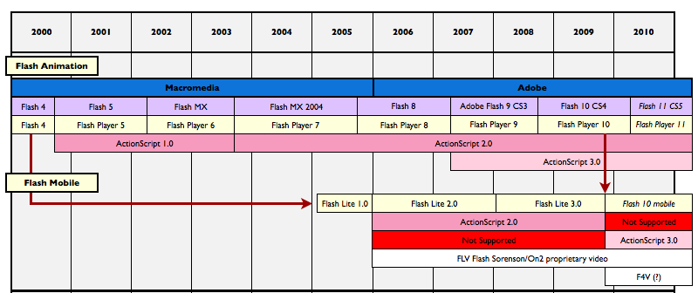
Actionscript

Slide 4
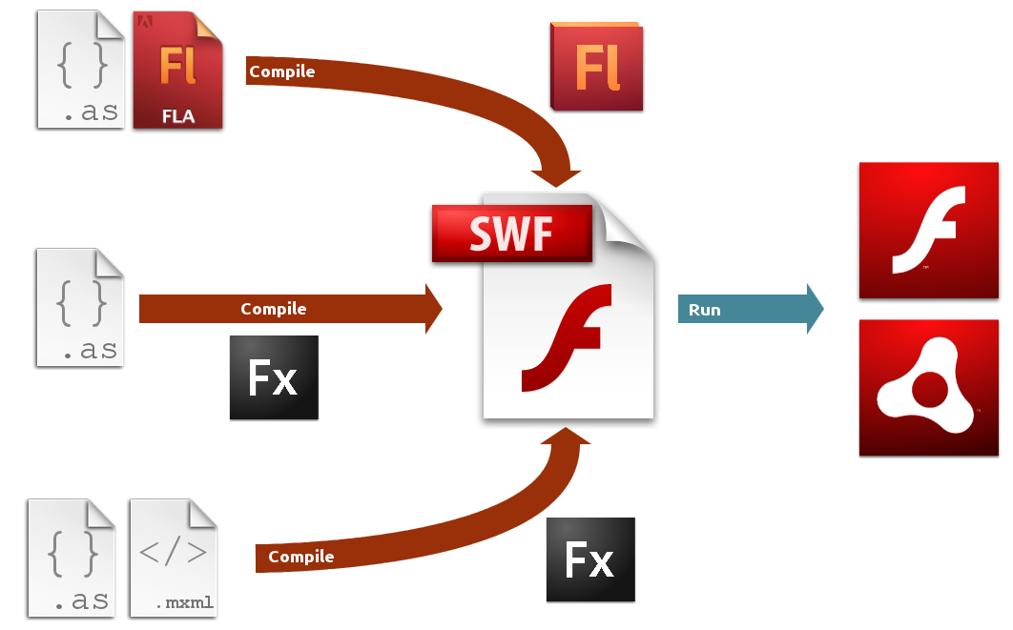
Development Lifecycle

Slide 5

Actionscript
ECMAScript Compliant (Javascript).
Interpreted Language (AVM1/2).
Compiled language (as bytecode).
Dynamic typing (Also supports static typing).
Object oriented.
Event-Driven.
Document Object Model (DOM) Level 3 Compliant.
Multimedia Programming oriented.
Virtual Machines:
  Flash Player
  Air Runtime
  GNU Gnash (open source)

Slide 6
Strict vs. Standard
Strict
Mode
Standard
Mode
Static Typing
Dynamic Typing
Implicit declaration
Unsealed Objects

Slide 7

General Language Syntax
Structured Programming:
Operators (in order of precedence):
Conditional Statements:
  if... else if … else
  switch... case... default
Iterations:
  while , do... while
  for ...
  for each...in
  for... in
Primary
[] {x:y} () f(x) new x.y x[y] <></> @ :: ..
Postfix
x++ x--
Unary
++x --x + - ~ ! delete typeof void
Multiplicative
* / %
Additive
+ -
Bitwise shift
<< >> >>>
Relational
< > <= >= as in instanceof is
Equality
== != === !==
Bitwise
&(AND) ^(NOT) | (OR)
Logical
&& (AND) || (OR)
Ternary Conditional
?:
Assignment
= *= /= %= += -= <<= >>= >>>= &= ^= |=

Slide 8
General Language Syntax
Native Data Types:
Object
int
uint
Number
Boolean
String
Date
Function
Class
Namespace
Error
RegExp
Array
Vector
XML + XMLList
Dictionary
Foundational
Numeric
Simple values
Language structures
Collections

Slide 9
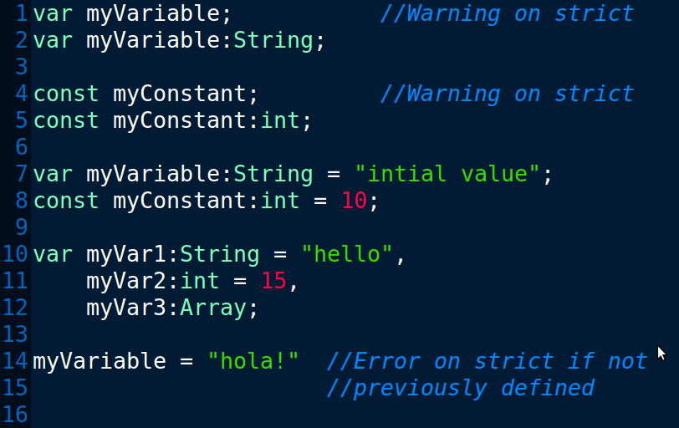
General Language Syntax
Variables and constants:

Slide 10
Functions
In actionscript functions are first-class types. Functions are objects.
Basic function concepts
- Calling functions
- Defining your own functions
- Returning values from functions
- Nested functions
Function parameters
- Passing arguments by value or by reference
- Default parameter values
- The arguments object
- The ... (rest) parameter
Function scope
- The scope chain
- Function closures
f(x)

Slide 11
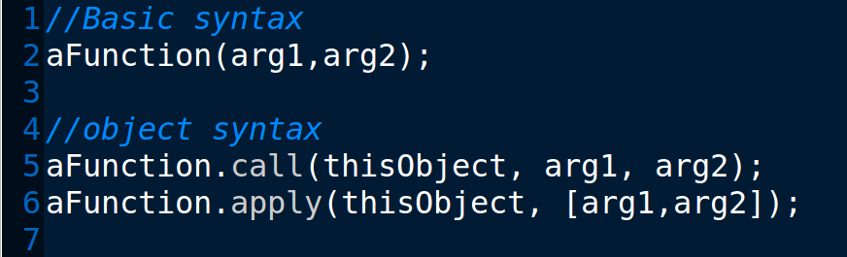
Functions
Calling functions:
f(x)

Slide 12
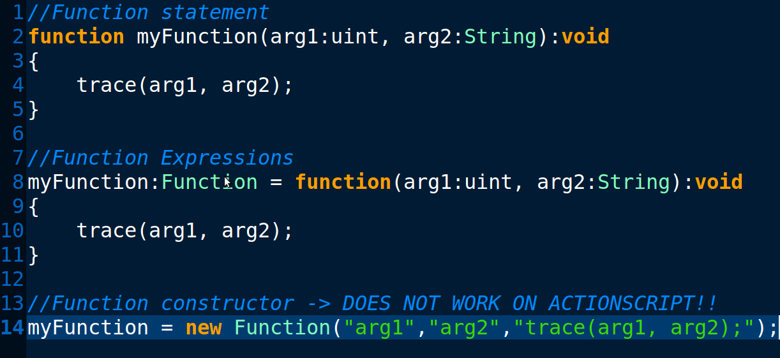
Functions
Defining your own functions:
f(x)

Slide 13
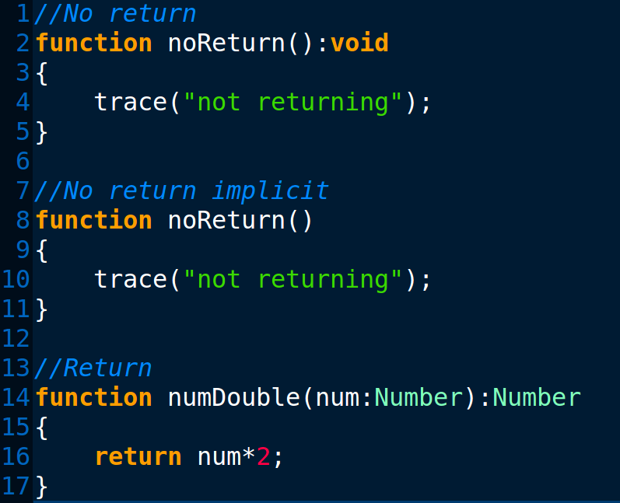
Functions
Returning values from functions:
f(x)

Slide 14
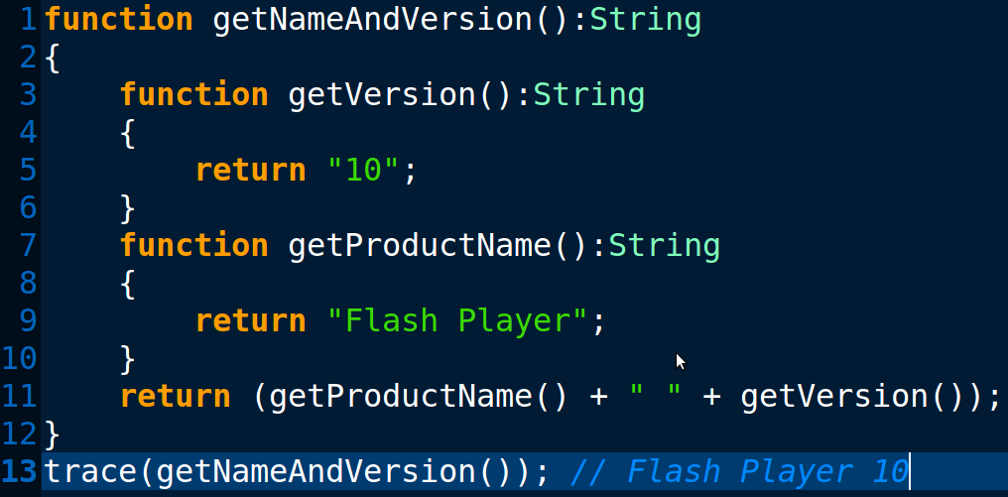
Functions
Nested functions:
f(x)

Slide 15
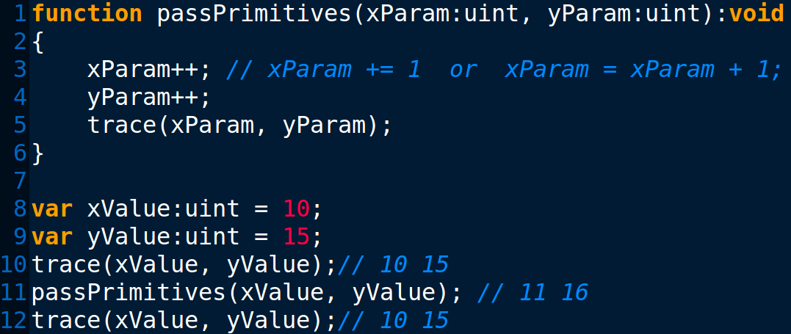
Functions
Function parameters
- Passing arguments by value or by reference
In actionscript all arguments are passed by reference, but primitive types operations behave as if passed by value.
f(x)

Slide 16
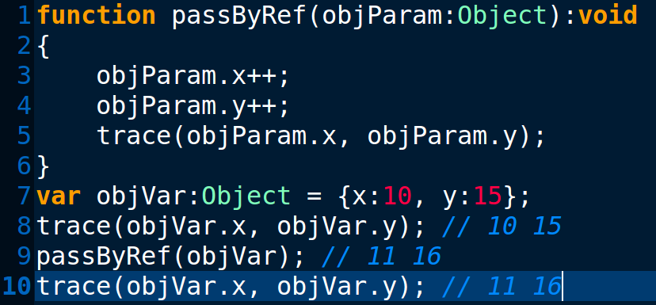
Functions
Function parameters
- Passing arguments by value or by reference
f(x)

Slide 17
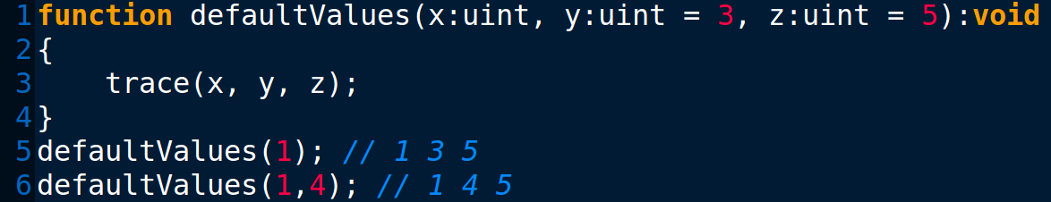
Functions
Default parameter values:
f(x)

Slide 18
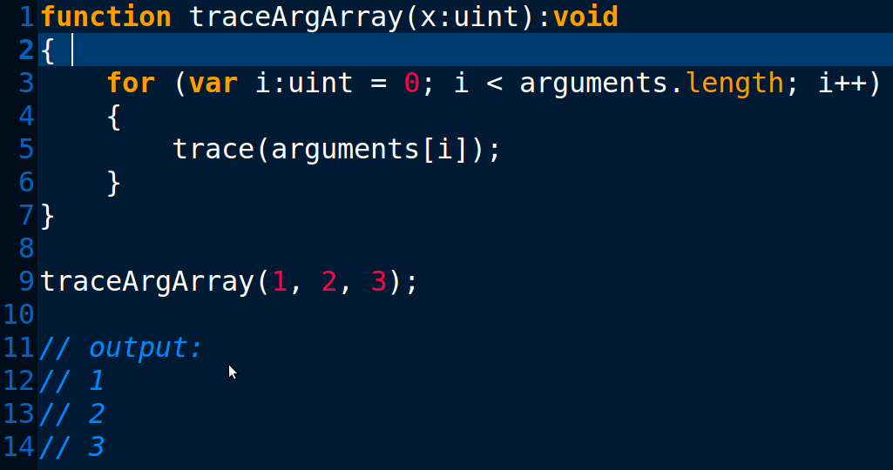
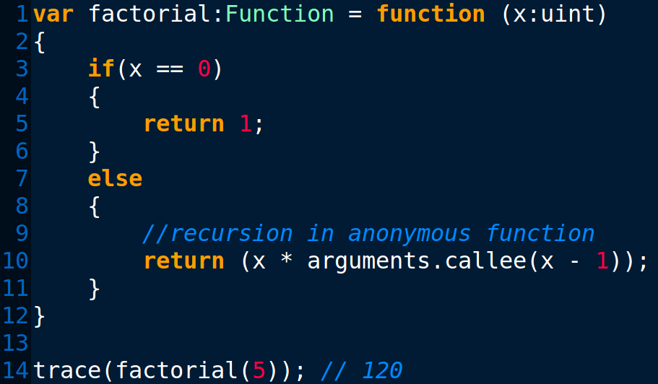
Functions
The arguments object:
f(x)

Slide 19
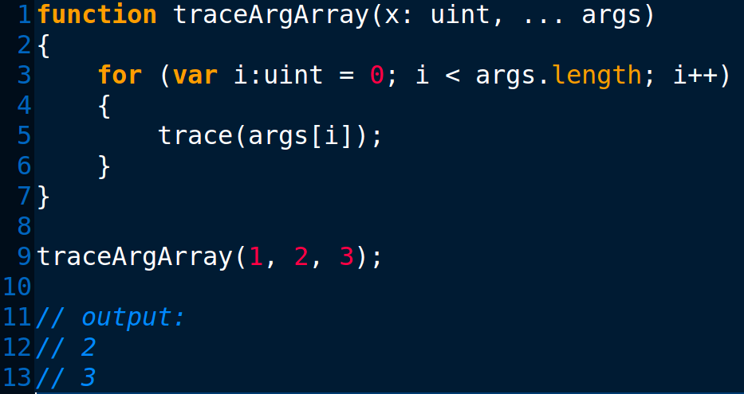
Functions
The ...(rest) parameter:
f(x)
The arguments object is not available if any parameter is named “arguments” or if you use the ...(rest) parameter.

Slide 20
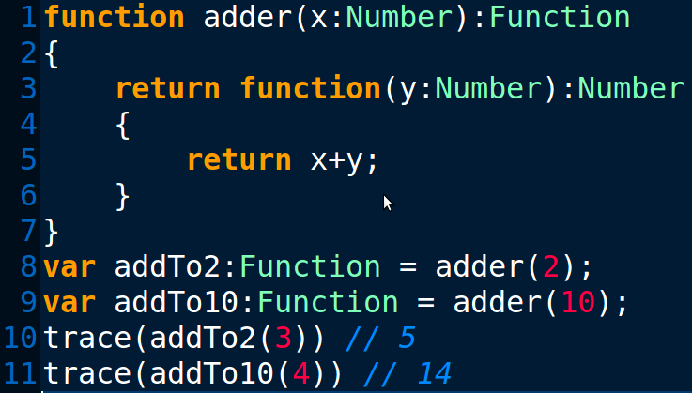
Functions
Closures:
A closure is a functional language feature that allows functions to retain the references from its lexical environment even after that environment is no longer in execution.
f(x)

Slide 21

Object-Oriented Programming
Class definitions
Class property attributes
- Access control namespace attributes
- static attribute
Class inheritance
Interfaces
Instantiation and access
Methods
- Constructor methods
- Static methods & Instance methods
- Get and set accessor methods
- Bound methods

Slide 22

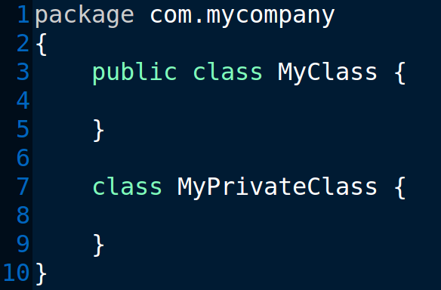
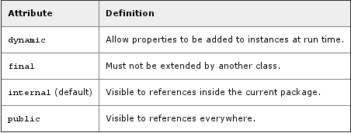
Object-Oriented Programming
Class definition:

Slide 23
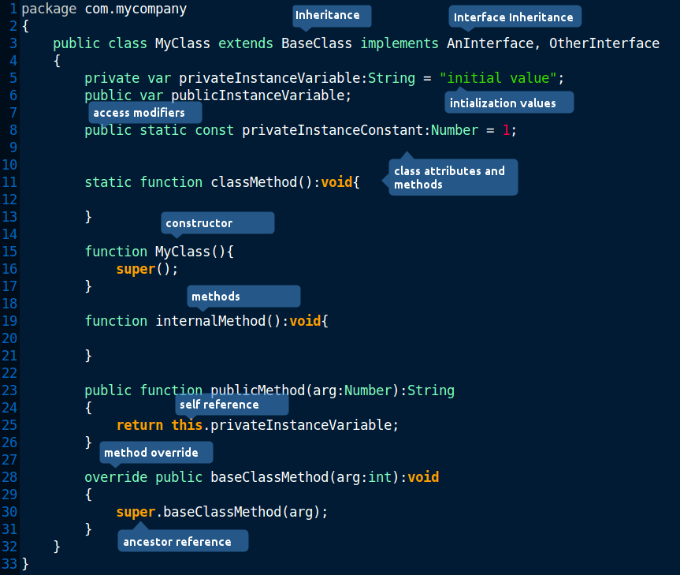
Object-Oriented Programming

Slide 24
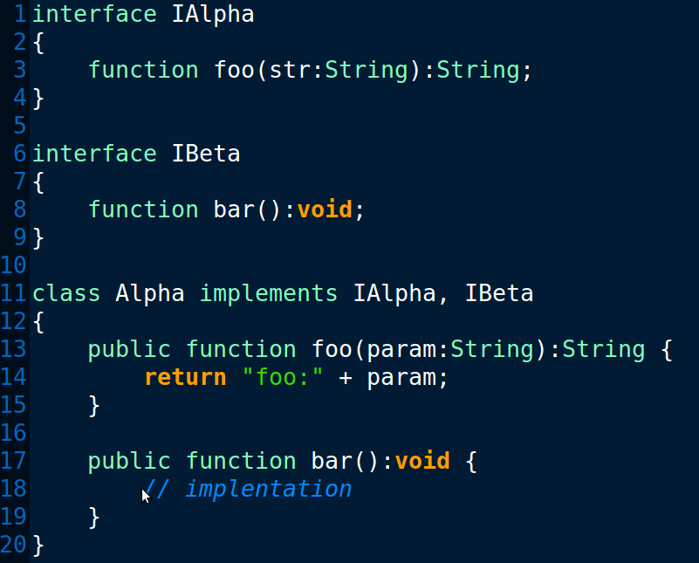
Object-Oriented Programming
Interfaces:

Slide 25
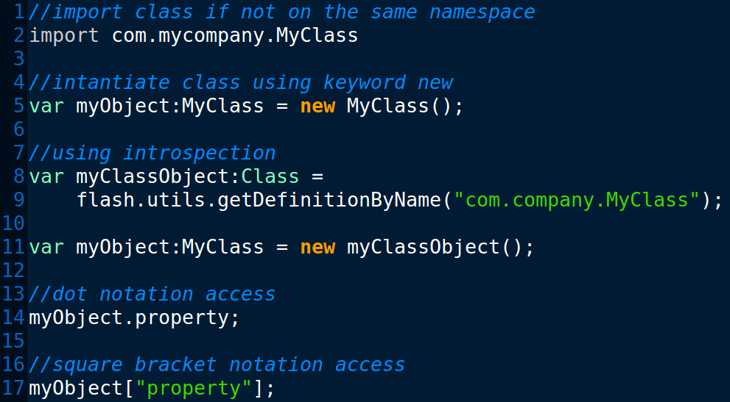
Object-Oriented Programming
Instantiation and access.

Slide 26
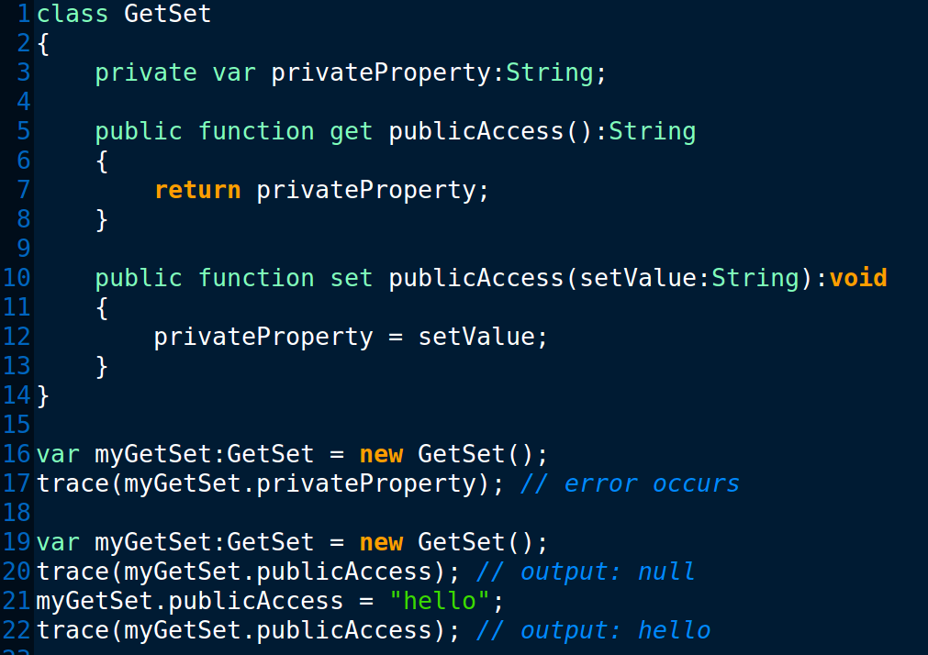
Object-Oriented Programming
Get and set accessor methods:

Slide 27
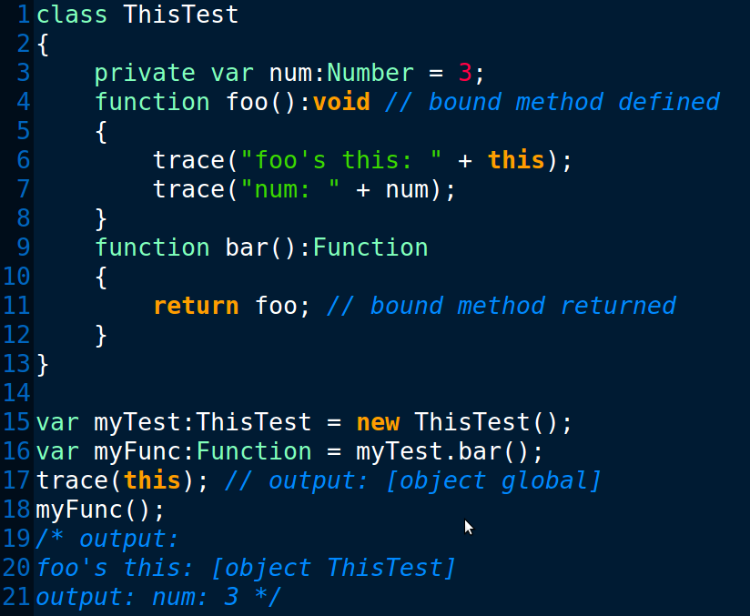
Object-Oriented Programming
Bound methods (method closures):

Slide 28
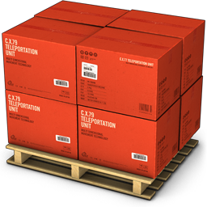
Object Collections
Arrays
Vector (Typed Array)
Associative Arrays (POJO)
Dictionary

Slide 29
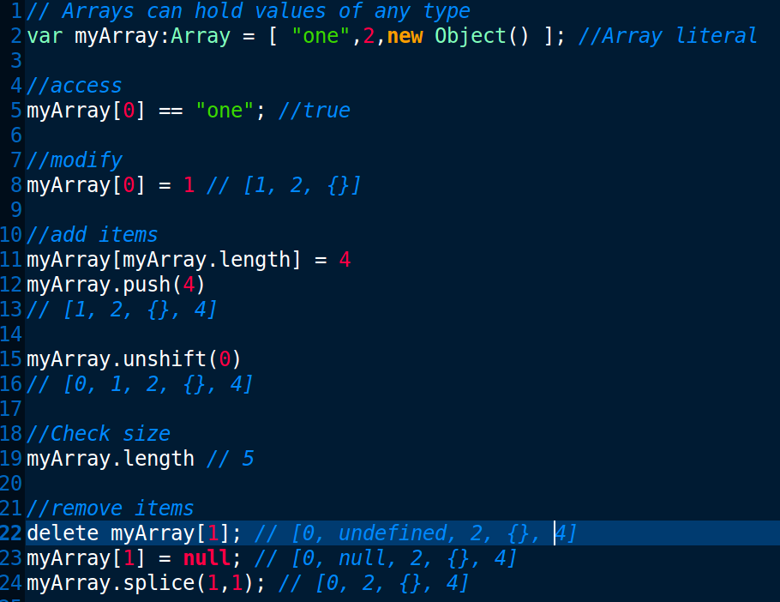
Object Collections
Arrays

Slide 30
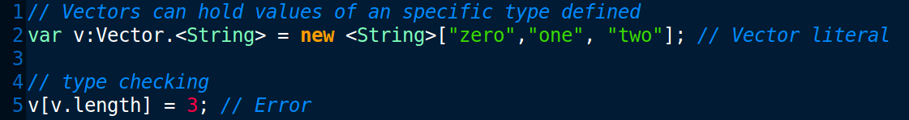
Object Collections
Vector (Typed Arrays)
Vectors provide type information that allows the compiler to optimize the bytecode.
Availability: Flash Player 10 +

Slide 31
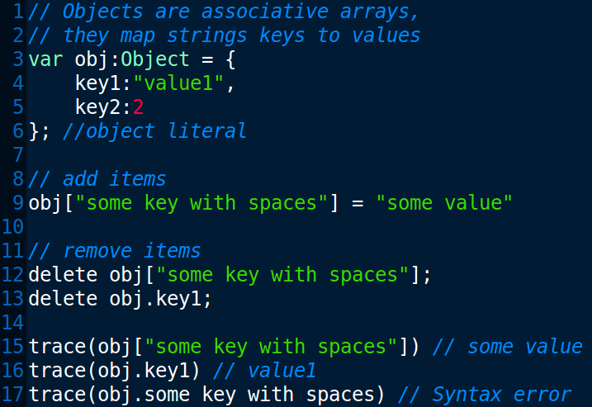
Object Collections
Associative Arrays (POJO)

Slide 32
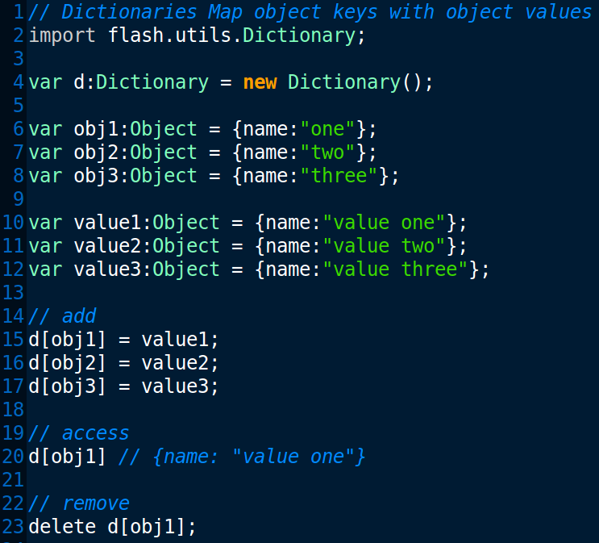
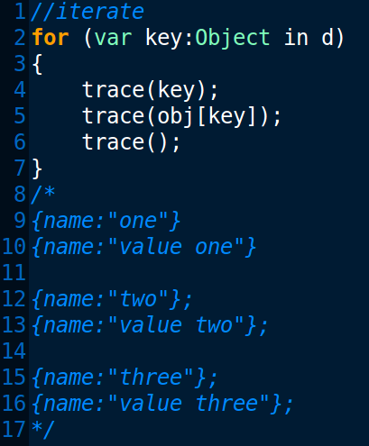
Object Collections
Dictionary ( flash.utils.Dictionary )

Slide 33
Thanks!
github.com/matix/as3basics
matias.figueroa@globant.com
@matixfigueroa

